Slide 1
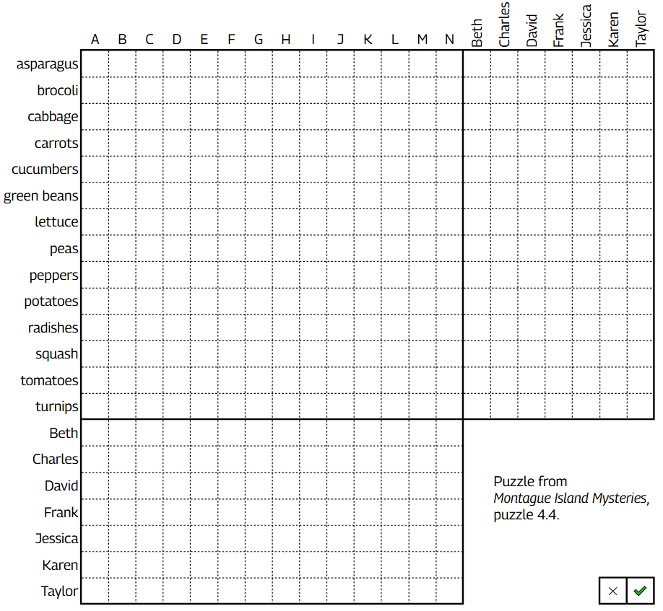
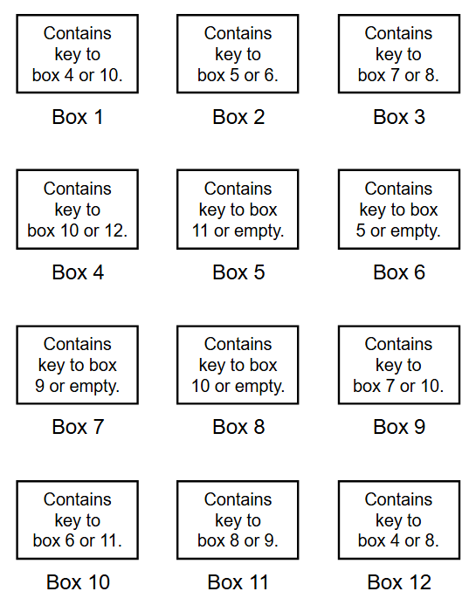
Logic Grids as Data Structures
Ryan Y. Batubara
#4: Garden plots
#2: Key deductions
Puzzle from Return to Montague Island, puzzle 1.1.

Slide 2
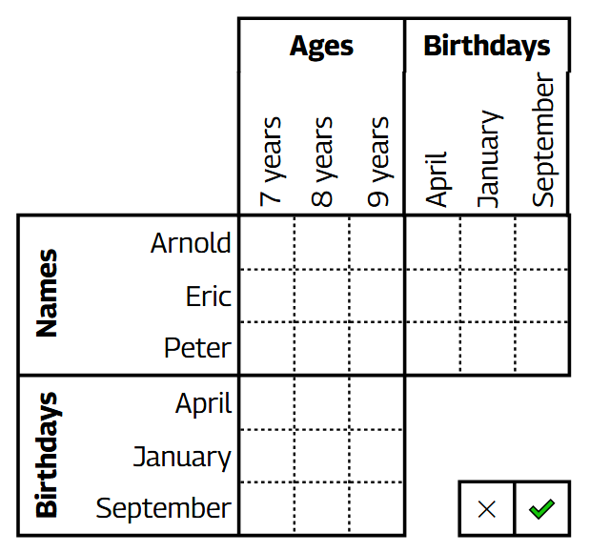
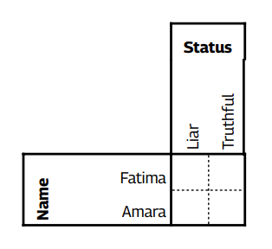
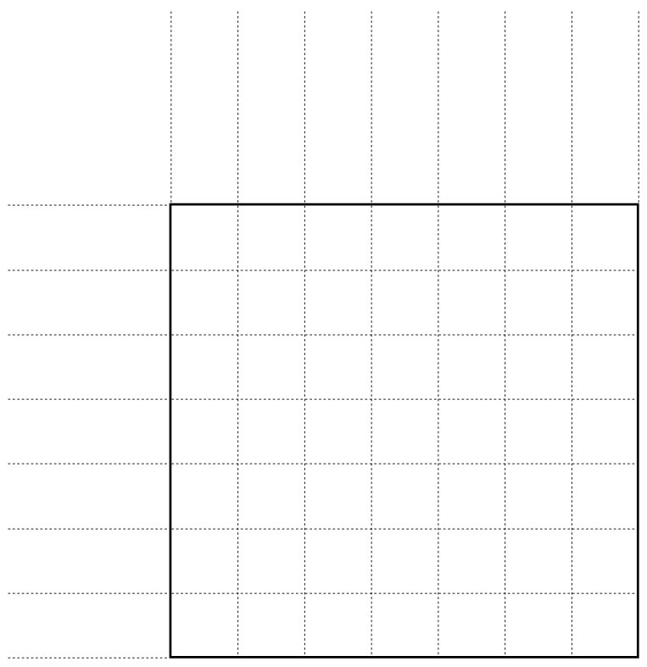
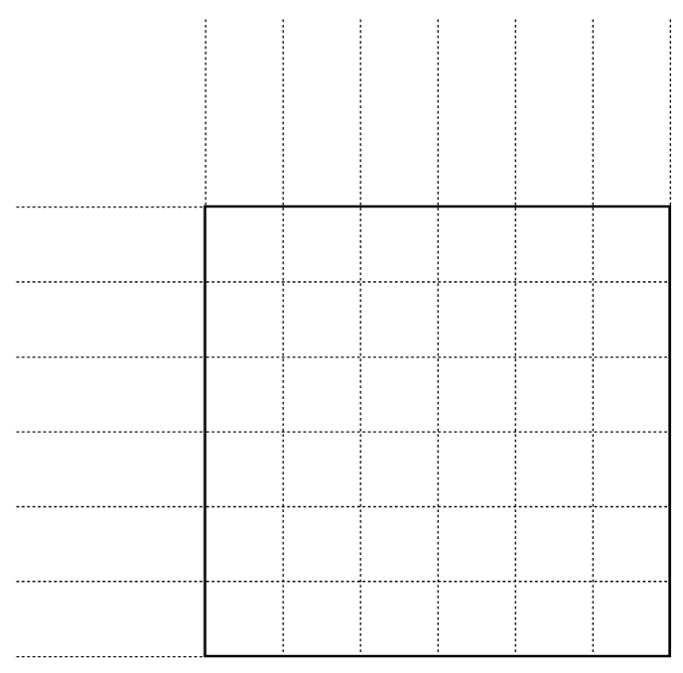
#1: Introducing logic grids
#3: Who’s the liar
Peter's birthday is in April.
Eric is 7.
Arnold was born in September.
Peter is 8.
Fatima and Amara come from a land where some always tell the truth, and the rest always lie.
Amara says, “Either Fatima lies, or I am truthful.”
From Brainzilla Basic Logic Grid 1.
From Truth & Lies Puzzle Generator
#6: Pilfer puzzle
#5: Murder mystery
Puzzle from Montague Island Mysteries, puzzle 12.4.
From Beyond Montague Island, puzzle 9.1.

